Slide 1

Intro to KnockoutJS
Forward Thinking

Slide 2
About
Steve Duitsman
@SteveDuitsman
steve.duitsman@centare.com

Slide 3
KnockoutJS
Client-Side MVVM JavaScript Library
40kb (minified), 166kb (debug)
No dependencies
Works on all mainstream browsers
IE6+, FF2+, Chrome, Safari, Opera
Developed with BDD
NuGet or knockoutjs.com

Slide 4

Features
Declarative Bindings
Dependency Tracking
Automatic UI Refresh
Templating

Slide 5
MVVM Pattern
MODEL
VIEW MODEL
VIEW

Slide 6
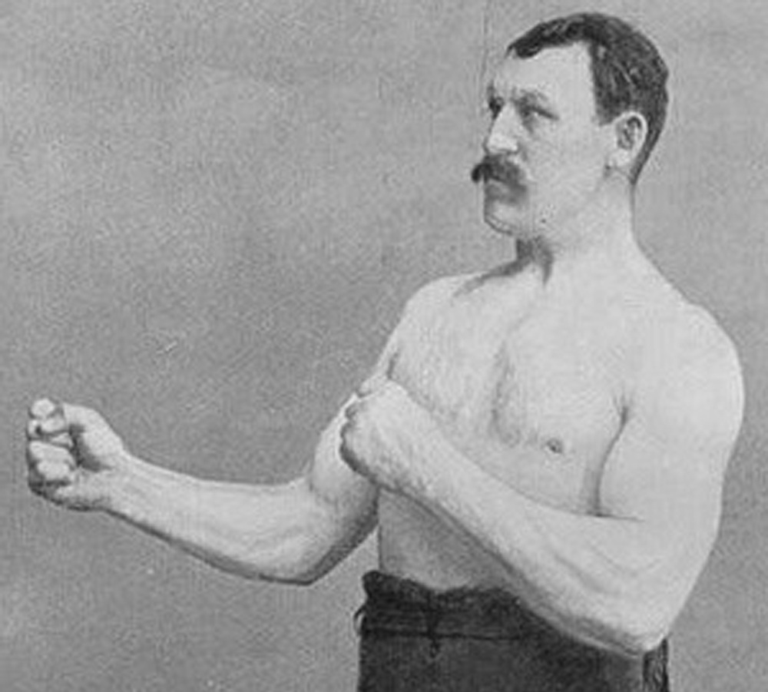
Demo

Slide 7
Basics
data-bind attribute
ko.observable()
Subscriptions
ko.applyBindings()

Slide 10

Why Knockout?

Slide 11
Why Knockout
High level link between UI & data model
Extensible
Usable in existing apps/architecture
Learning Resources
Same MV* pattern & benefits as other solutions
It boils down to:
Scope & Feel

Slide 12
Resources
knockoutjs.com
Live Examples/Tutorials
Documentation
Knock Me Out - Ryan Niemeyer’s blog
PluralSight Courses
Knockout Fundamentals
HTML5 and JS Apps With MVVM and Knockout
SPAs with HTML5, WebAPI, Knockout and jQuery

Slide 13
Questions

